Slide 1
Grade Predictor
By: Tyler Garfield, Kevin Pratt, David Rincon Villanueva, Ferdous Khan

Slide 2
Our Problem
The dataset: Student Performance and Behavior Dataset from Kaggle
https://www.kaggle.com/datasets/mahmoudelhemaly/students-grading-dataset
Motivation: Try and identify main predictors that contribute to passing or failing in a course.

Slide 3
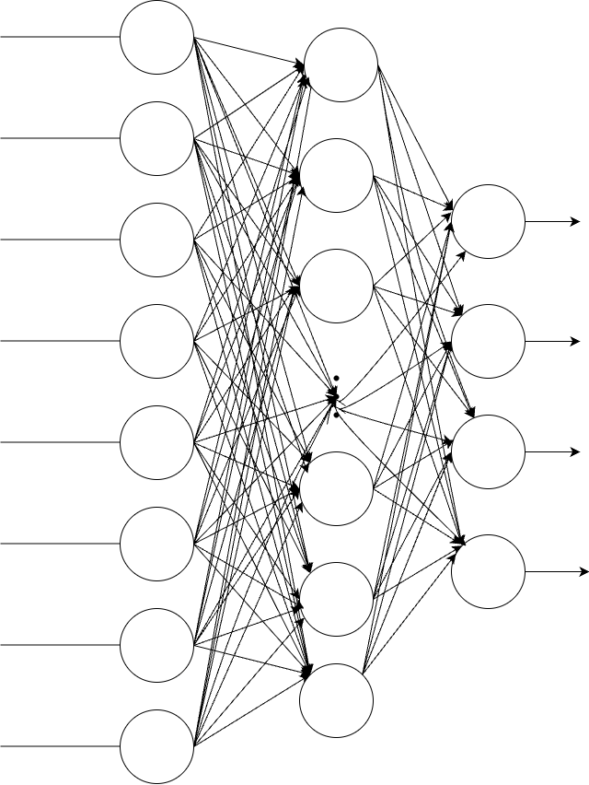
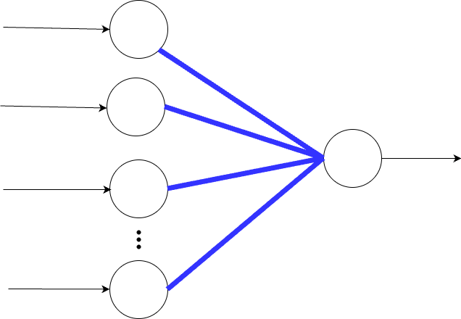
Approach
Started by using an FFNN with one hidden layer but the model was very unstable.
We ended up altering our goal slightly from predicting grade to predicting pass fail and using an average perceptron.
Used Pearson Correlation coefficients to determine best predictors to use
Switched to predicting at three locations, before first midterm, after midterm, and after final.

Slide 4
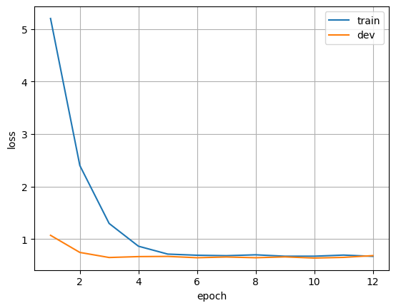
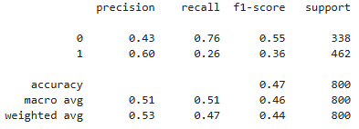
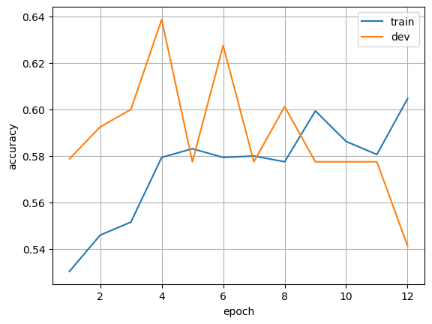
FFNN performance

Slide 5
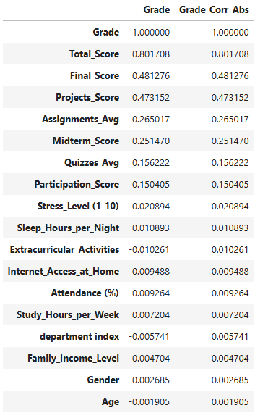
Pearson Correlation
Coefficients

Slide 6
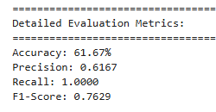
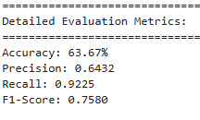
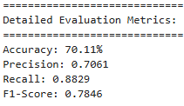
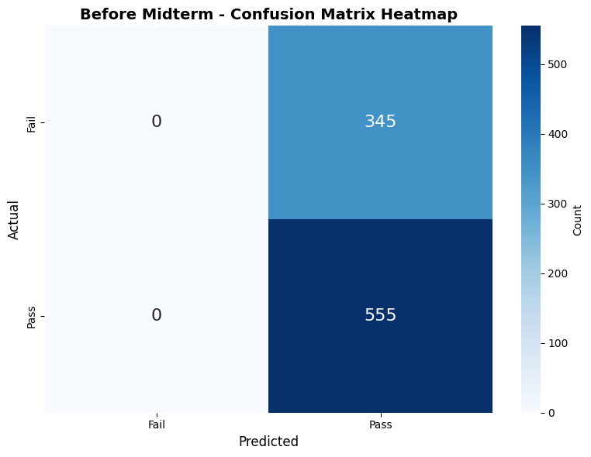
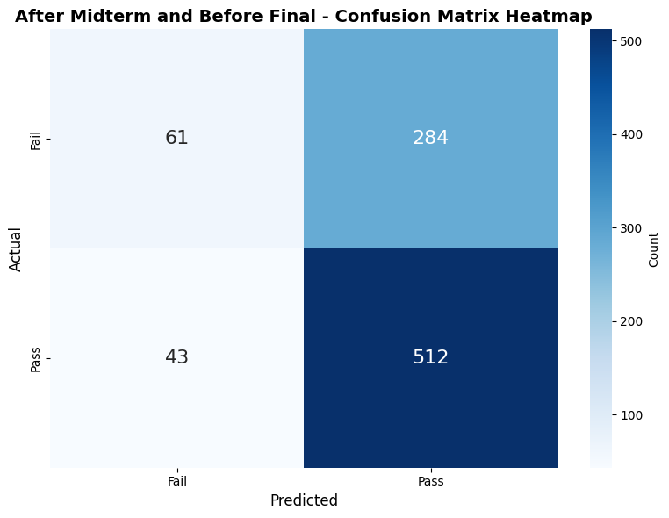
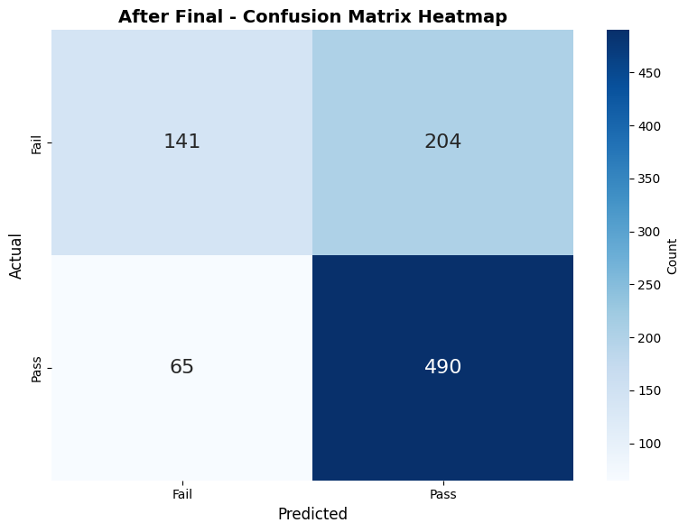
Average Perceptron Performance
Before Midterm
Before Final
After Final

Slide 7
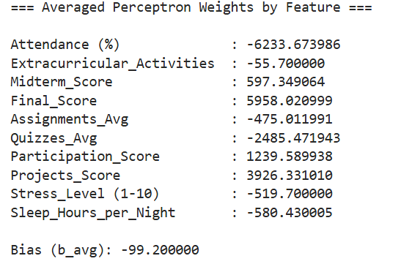
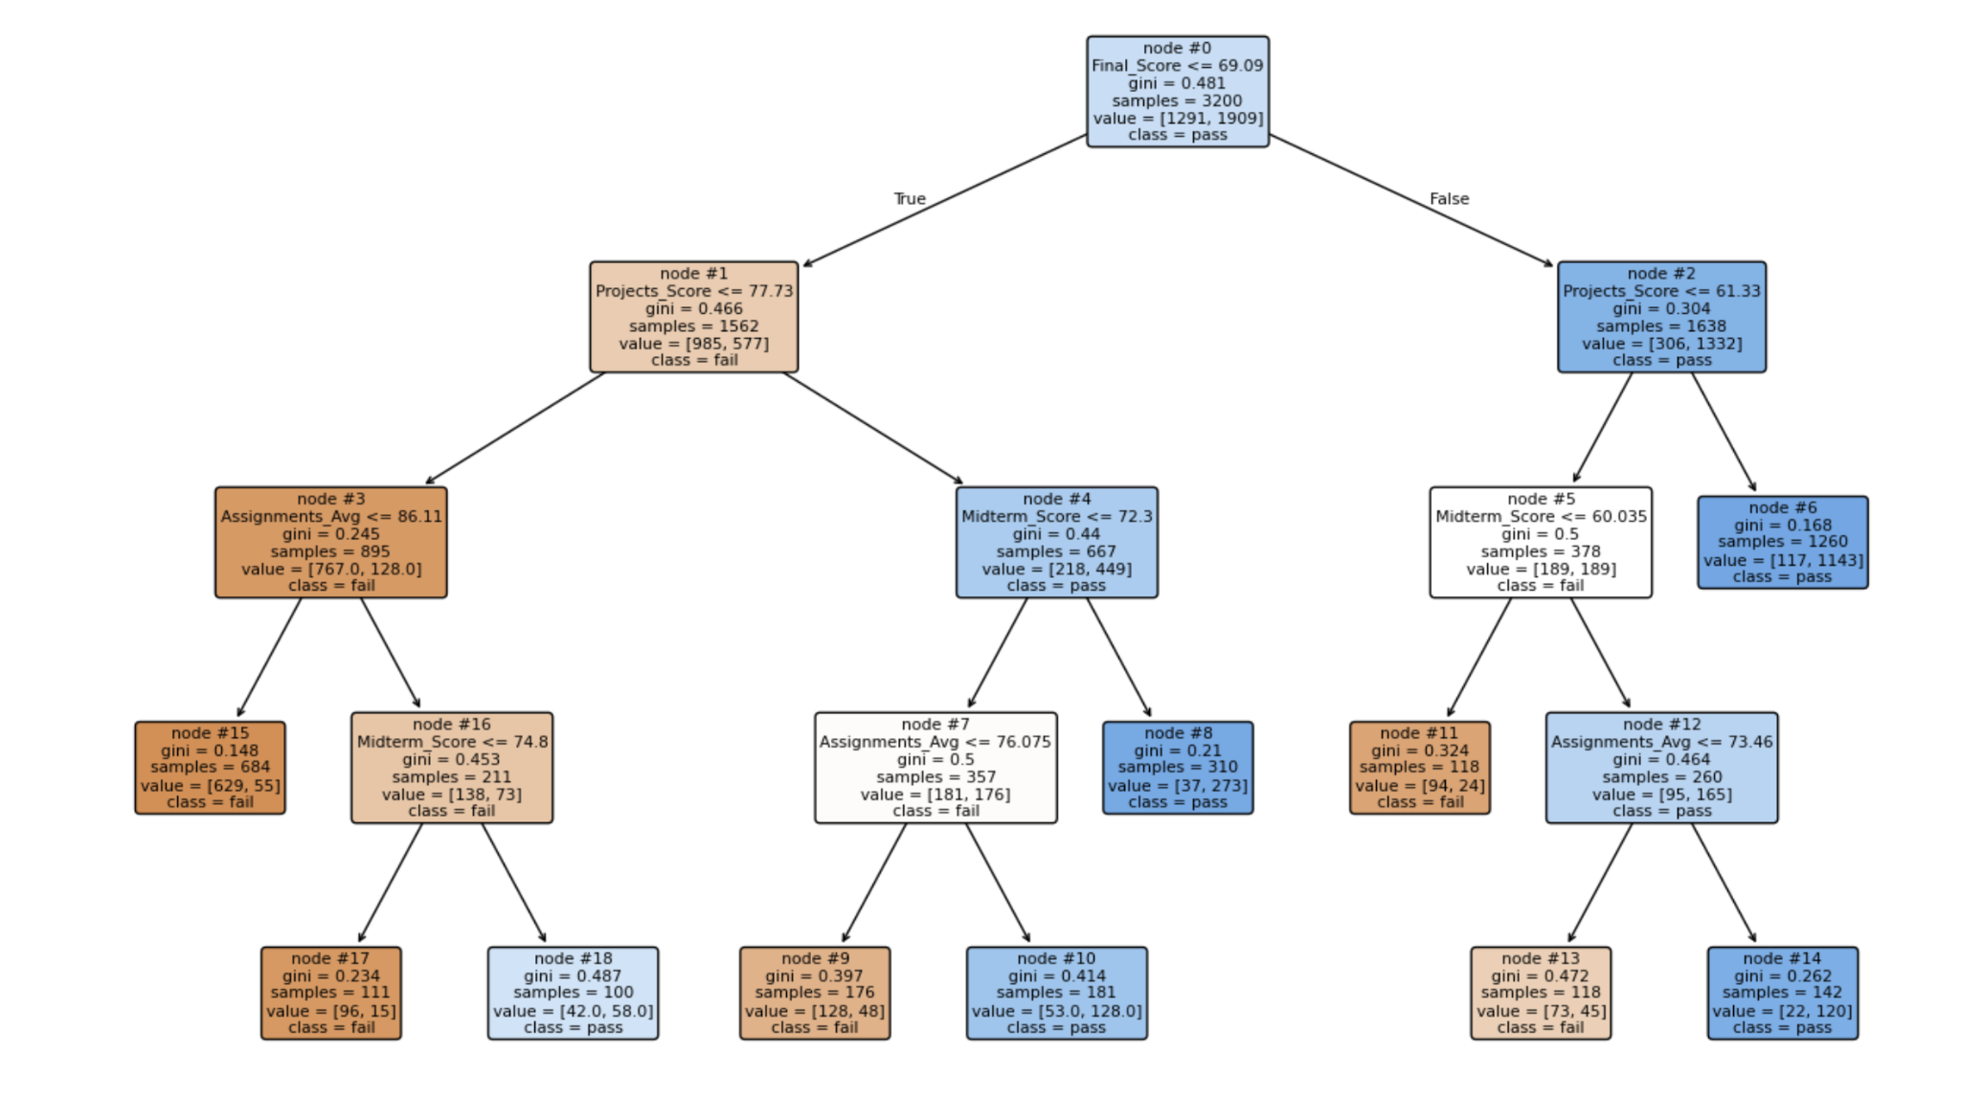
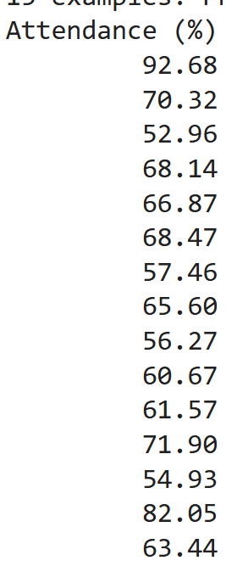
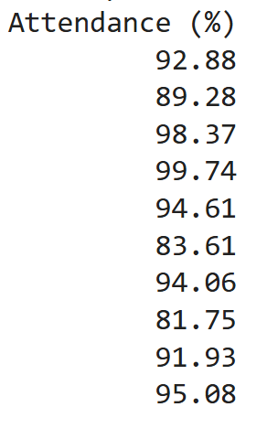
Error Analysis
False Positives:
False Negatives:
Notes:
Path to go through: [ 0 1 3 16 17]
Voting perceptron or other non-linear classifier would be better
Weights are super weird. We tried some correlation coefficients to reduce the columns we are using

Slide 8
Contributions
Tyler: Team assembly, meeting coordination, helped with trying to tune FFNN (changing hyperparameters, trying feature weighting in loss func, trying SMOE to artificially balance classes), came up with initial perceptron implementation.
Kevin: Handled gib hub branches, helped create code for FFNN, helped clean the data before using it. Helped test alterations of FFNN, helped with presentation, helped with decision tree code. Helped with error analysis.
Ferdous: Helped create code for the error analysis and find the comparisons between data points using pearson coefficients and decide next steps, helped clean data before using the csv file, helped with presentations.
David: Converted Tyler’s initial perceptron into an average perceptron and trained perceptron on three time periods. Did pearson correlation coefficients for perceptron implementation. Created heatmaps and made the evaluation metrics for three time periods.

Slide 9


Why we deserve an A?
“Success doesn’t just happen. It is a product of hard work, grit and ingenuity.” - Ogwo David Emenike
Set out to solve a problem extremely useful for student population, predicting a students grades in a given course.
Used fundamental concepts in this course, FFNN and perceptron, to attempt to solve our original problem of predicting a given students final letter grade.
  Tried techniques such as hyperparameter tuning, weighting the loss function, and synthetically balancing our dataset to improve bad performance.
  Implemented Vanilla Perceptron thinking that a simple model would be better.
  Kept on improving from there attempting to implement a average perceptron.
We humbled ourselves and asked for help when we hit a roadblock that we couldn’t get past.
Then implemented the feedback to gain invaluable insights about the performance of our model and our dataset.
Implementing this feedback then led to us discovering that our problem was potentially a non-linear one which is a massively important insight.
We never gave up, attempted to solve the problem to the best of our abilities, stopped and asked for help, implemented that help, learned how we could do even better in the future

